Slide 1
Lecture 3
Game Development

Slide 2
For this lecture open a new project
and bring a red cube in the scene

Slide 3
Asset and Packages in Unity
Unity packages are a handy way of sharing and re-using Unity projects and collections of assets;
Unity Standard Assets and items on the Unity Asset Store are supplied in packages, for example. Packages are collections of files and data from Unity projects, or elements of projects, which are compressed and stored in one file, similar to Zip files.
Like Zip files, a package maintains its original directory structure when it is unpacked, as well as meta-data about assets (such as import settings and links to other assets).

Slide 4
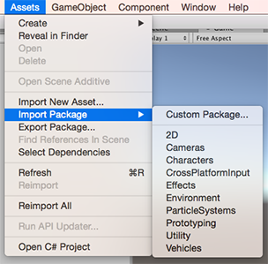
Import Asset/Package

Slide 5
Package Manager in Unity
Use the Unity Package Manager (in Unity’s top menu: Window > Package Manager) to view which packages are available for installation or already installed in your project.
In addition, you can use this window to see which versions are available, and install, remove, disable, or update packages for each project.

Slide 6
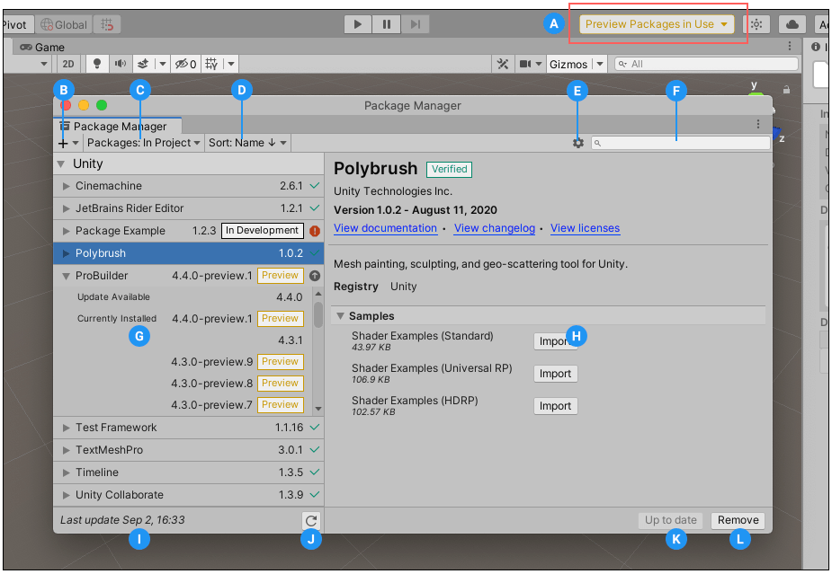
Package Manager in Unity

Slide 7
What is a skybox
A Skybox is a 6-sided cube that is drawn behind all graphics in the game.
Make 6 textures that correspond to each of the 6 sides of the skybox and put them into your project's Assets folder.
For each texture you need to change the wrap mode from Repeat to Clamp.

Slide 8


What is a skybox

Slide 9
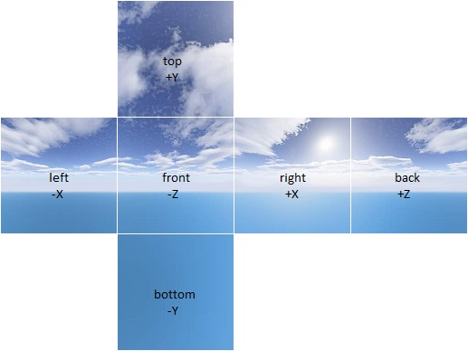
Skybox

Slide 10
How to download and import a Skybox
Open Windows→Asset store
Login using unity username and password
Search a free skybox
Add to your assets
Open Windows→Package Manager
Select Packages: My Assets
Search the asset you added from asset store, download and import it

Slide 11
Frame Rate in Unity
It is the speed at which those images are shown, or how fast you “flip” through the book.
It's usually expressed as “frames per second,” or FPS.
So if a video is captured and played back at 24fps, that means each second of video shows 24 distinct still images

Slide 12
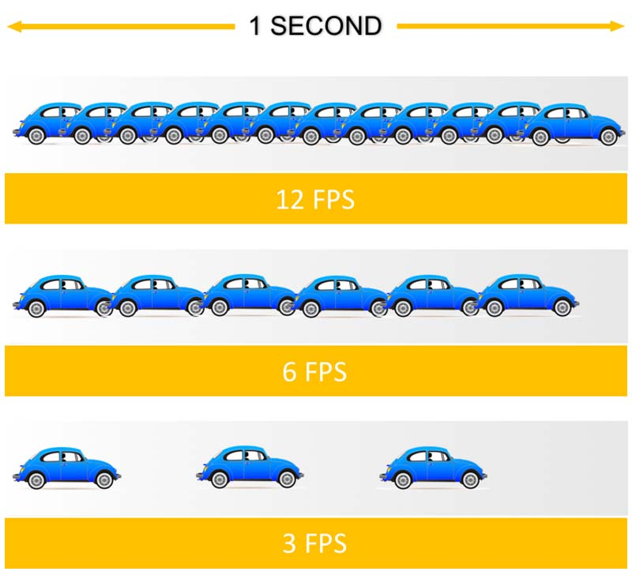
Frame Rate in Unity

Slide 13
Script in Unity
Add a component to cube – new script
Script name can be cubeMove, create and Add in script folder, open it by just clicking the script name. (A visual studio c# file open)
See what built-in methods script already has →Start method and Update Method
What are these methods:
Start is called exactly once in the lifetime of the script.
Update is called every frame
You will also see some Unity libraries and header files.

Slide 14
Script in Unity
How to move the cube in straight line:
Change its x position through script
In update method write the following lines:
transform.Translate(1f, 0, 0); for right movement
transform.Translate(-1f, 0, 0); for left movement or Vice vera depending on the initial position of your cube.

Slide 15
Script in Unity
How to move the cube upwards or downwards
Change its y position through script
What could be code??

Slide 16
Script in Unity
How to move the cube upwards or downwards
Change its y position through script
What could be code??
transform.Translate(0, 1f, 0); for upward movement
transform.Translate(0, -1f, 0); for downward movement or Vice vera depending on the initial position of your cube.

Slide 17
Audio in Unity
Select the cube and add new component →audio source to it
Download an audio of car from google classroom and add it to the project as asset
Assign it as audio clip in audio source.
What if you want to hear car horn sound by pressing “H” key?
How can you add a car from unity asset store in the scene instead of cube and make it move through left, right, up, and down arrow keys?
And also assign a horn sound with “H” key.

